Slide 1
Front End Engineering-I Project
Team Details:
AARADHYA MANAK(1754)
AARON VIJAY SINGH(1755)
AASTHA MALIK(1756)
Faculty Coordinator:
DR. RATTANDEEP ANEJA
:
Chitkara University Institute of Engineering and Technology,
Chitkara University, Punjab

Slide 2
Table of Contents
Introduction
Problem Statement
Technical Details
Key Features
Project Highlights
Conclusion
References/Links used

Slide 3
Introduction
TITLE: Bigg Boss Voting Zone
PURPOSE AND DETAILS:
This project is a Html and CSS based ‘Bigg Boss Voting Zone’ that allows the user to vote for their favourite contestant in an interactive and easy form.

Slide 4
Problem Statement
A voting platform is to be designed to show the increase/decrease in the votes of particular contestant using html and css.
The platform should look quite dynamic to show the progress bars of each contestant.

Slide 5
Technical Details
HTML AND CSS BASED VOTING ZONE:
Software used:Notepad++
Basic html knowledge regarding interlinking,
creating classes, use of div tags,etc.
Basic CSS knowledge regarding animations,padding,types of CSS,text modifications,etc.

Slide 6
Key Features
Bigg Boss cover page and its ott logo to give a sense of security in minds of the users.
Navigaton buttons given to navigate between different webpages through interlinking.
The ‘User Details’ page is assigned to collect the user info of the voters.
Animations are used on the Contestant page to make it look professional and skillful.
Thanks page to assure the voters that their vote has been registered.
Results page to display the result.

Slide 7
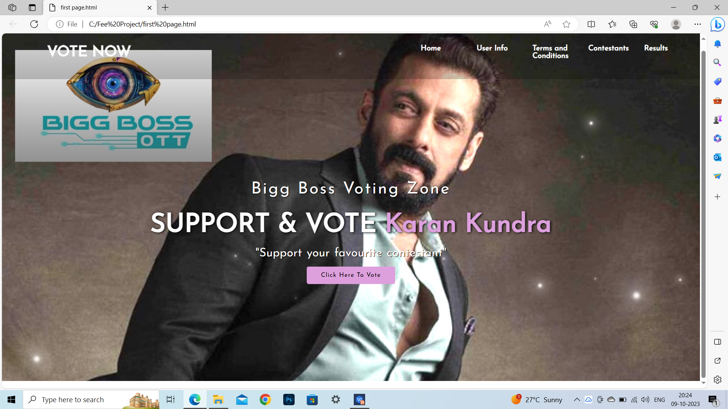
Project Highlights
FIRST PAGE

Slide 8
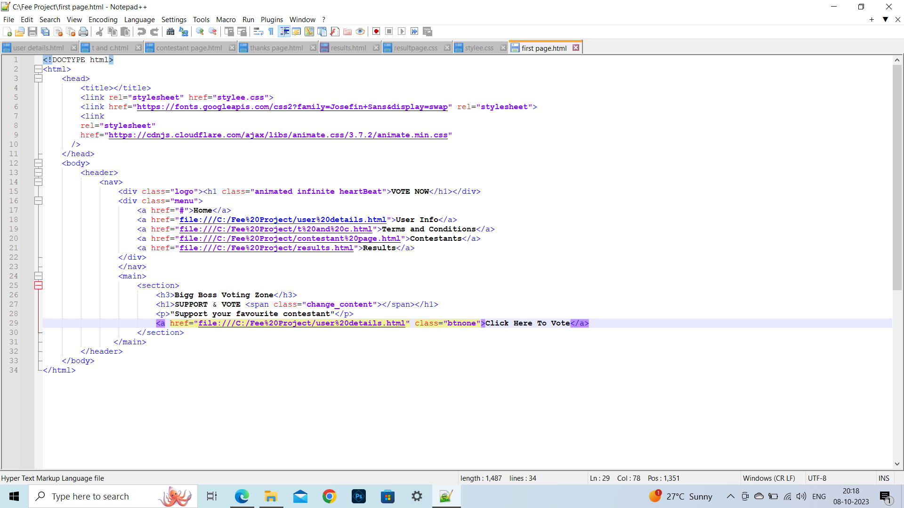
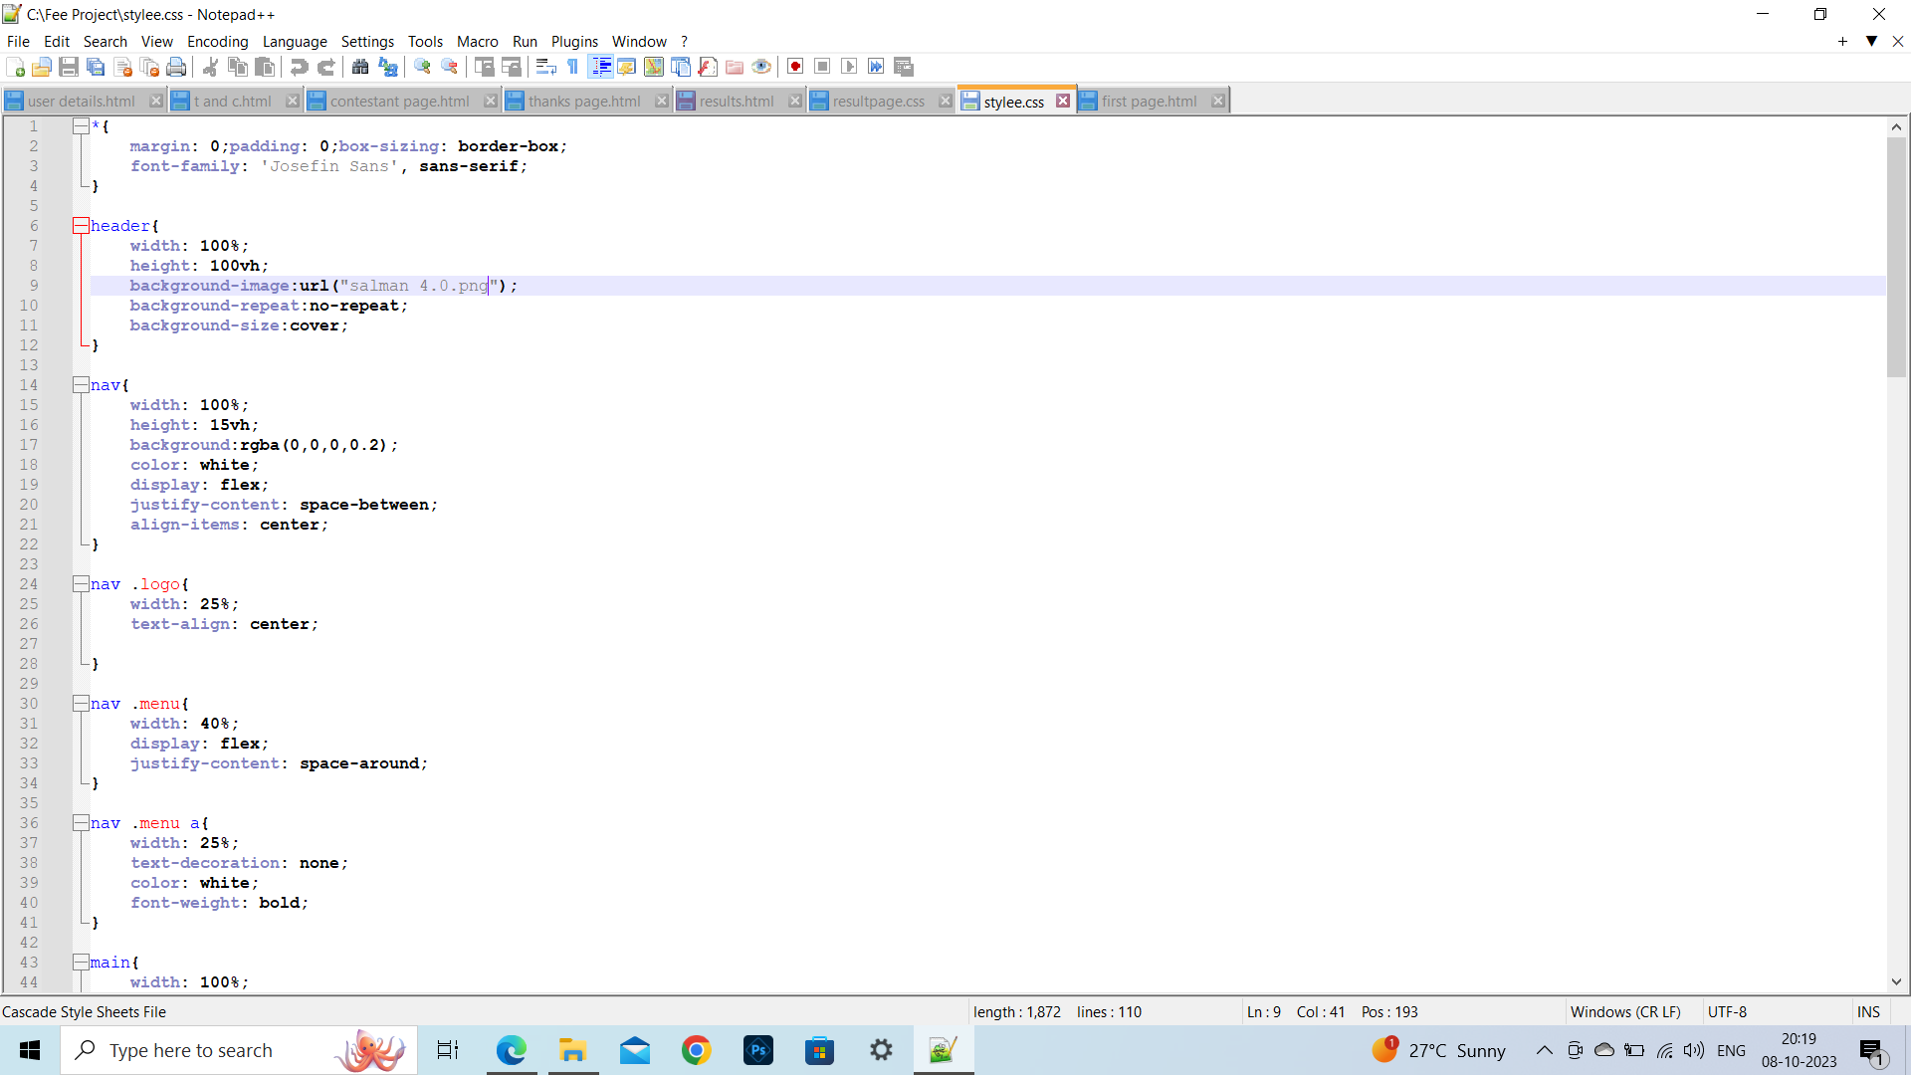
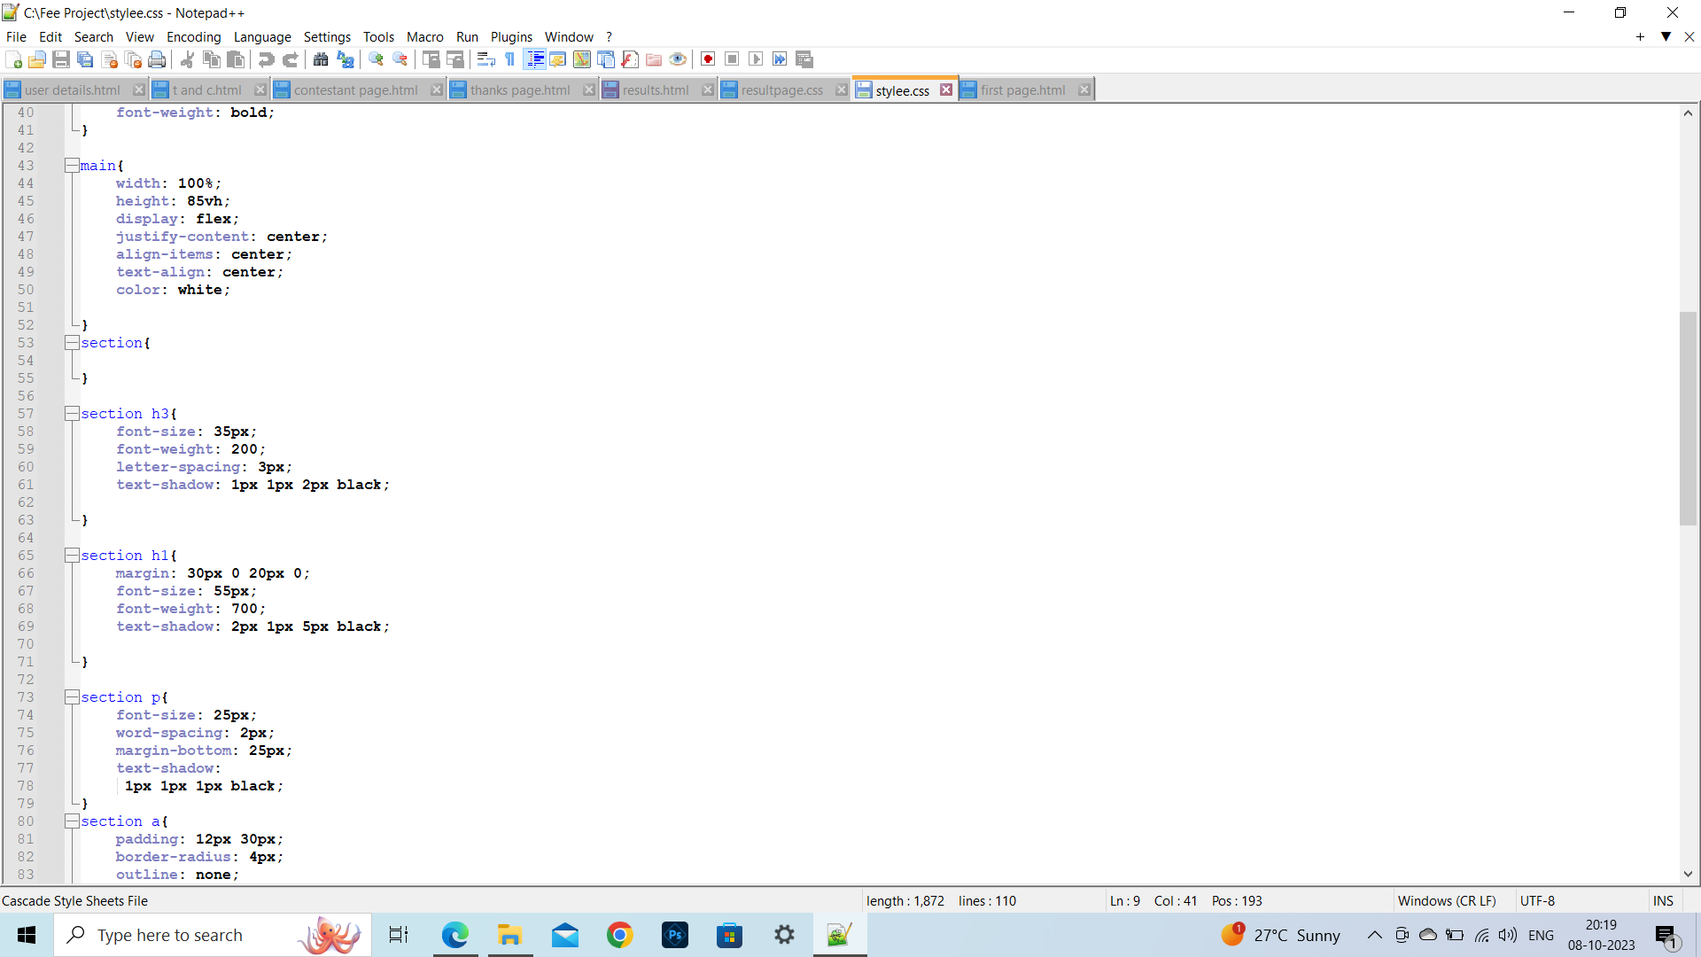
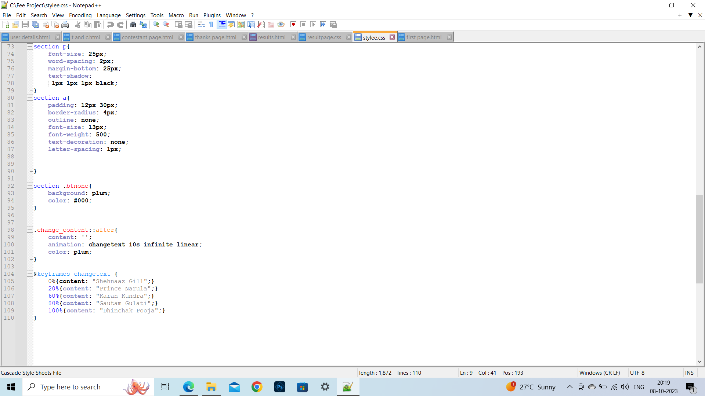
html code
CSS code part 1
CSS code part 2
CSS code part 3

Slide 9
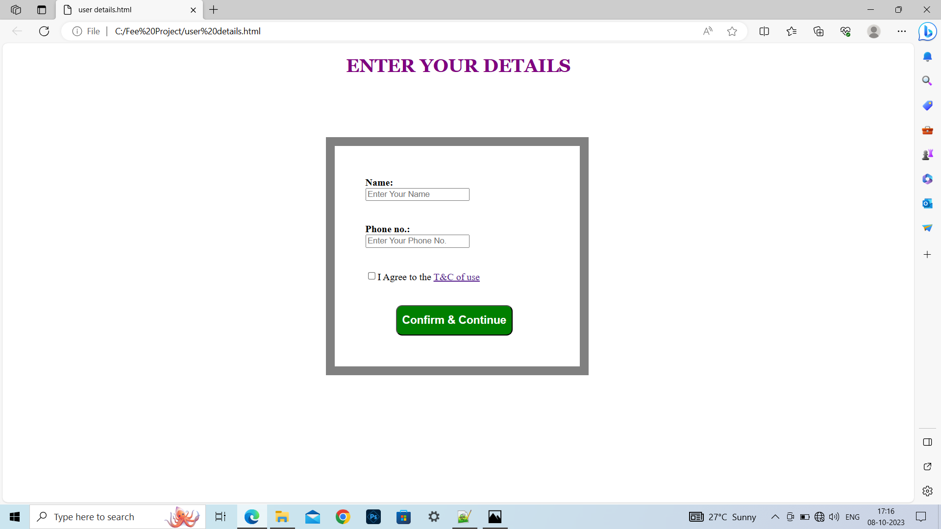
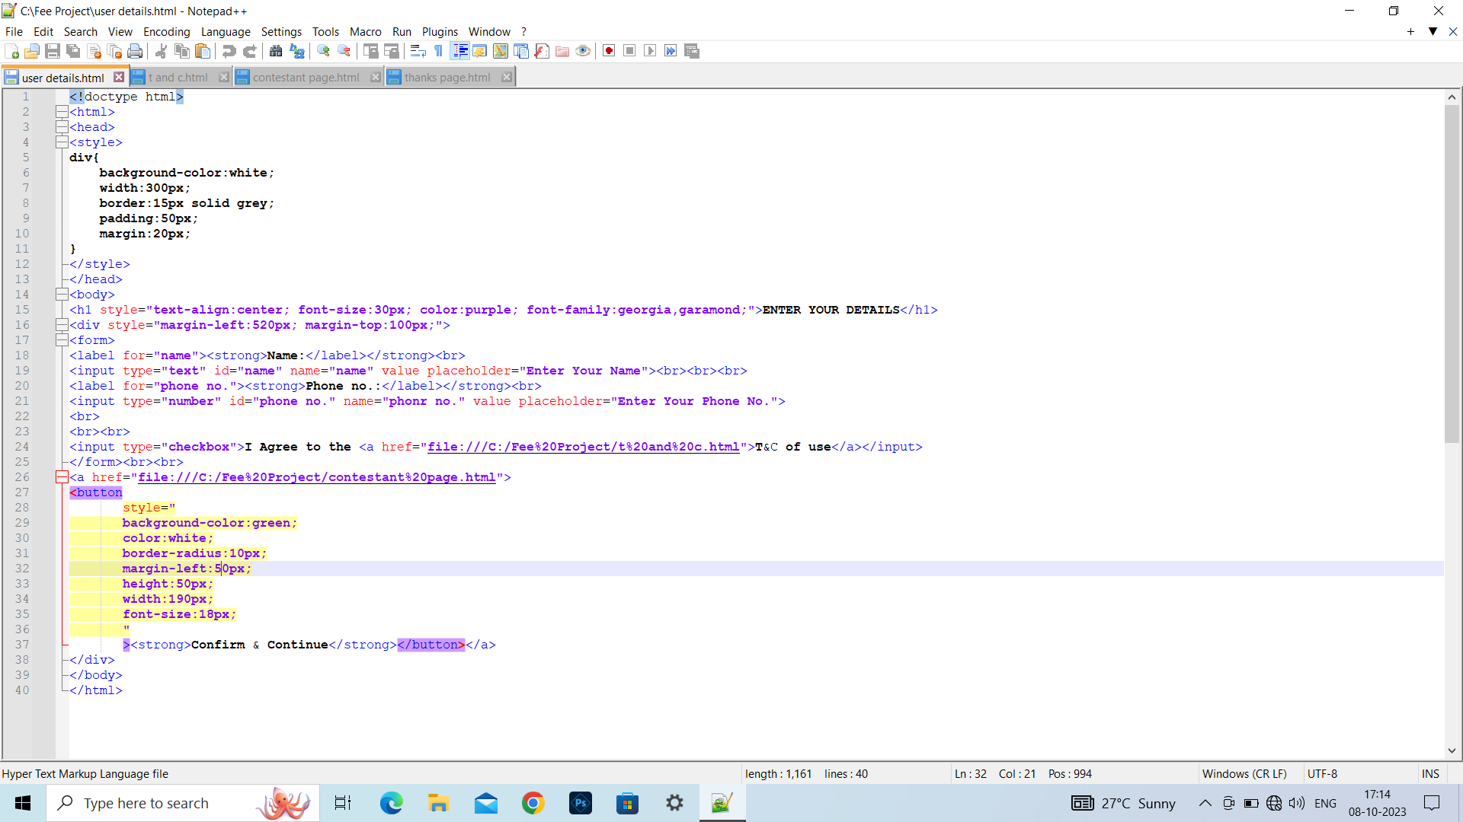
USER DETAILS PAGE

Slide 10
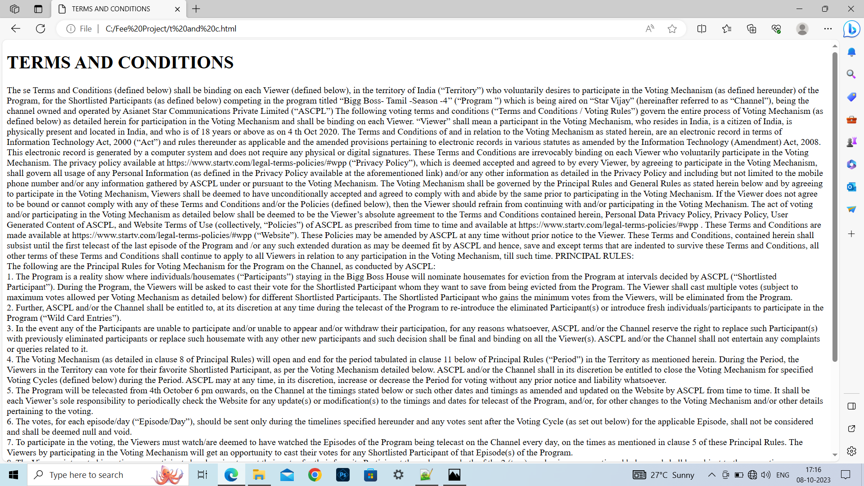
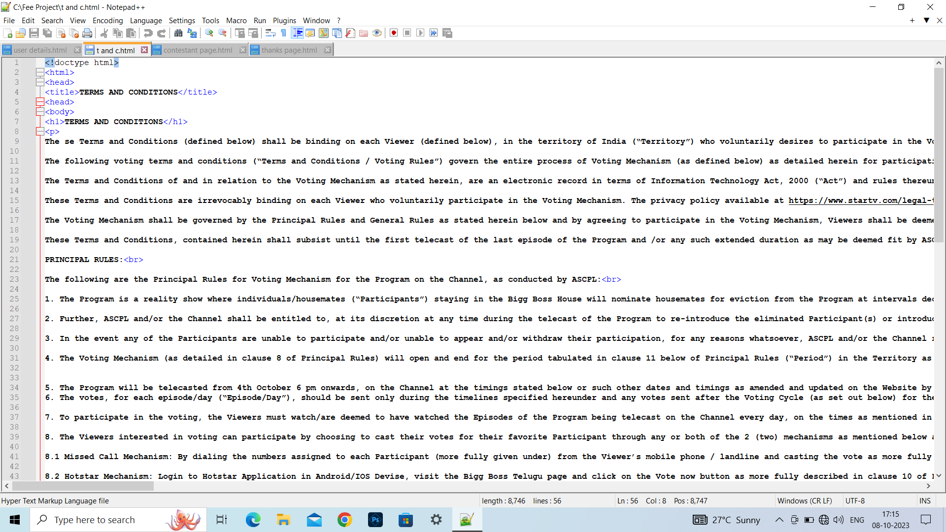
TERMS AND CONDITIONS PAGE

Slide 11
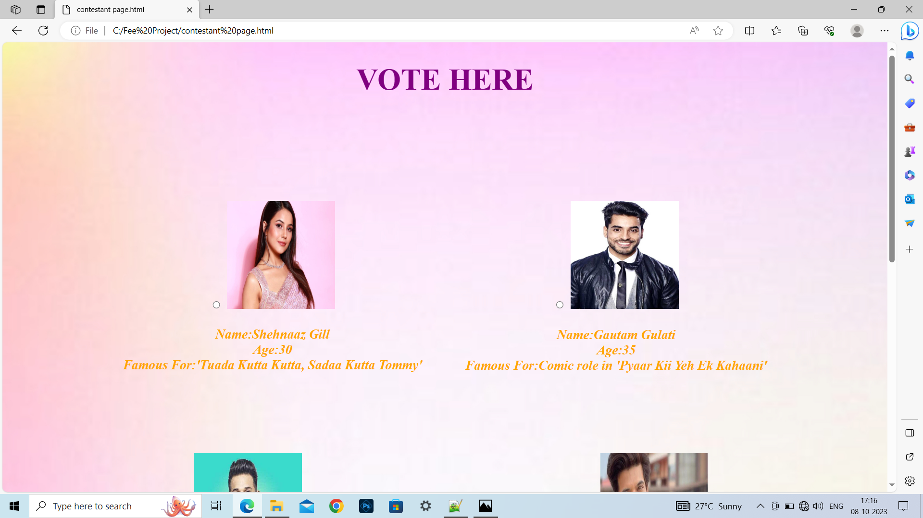
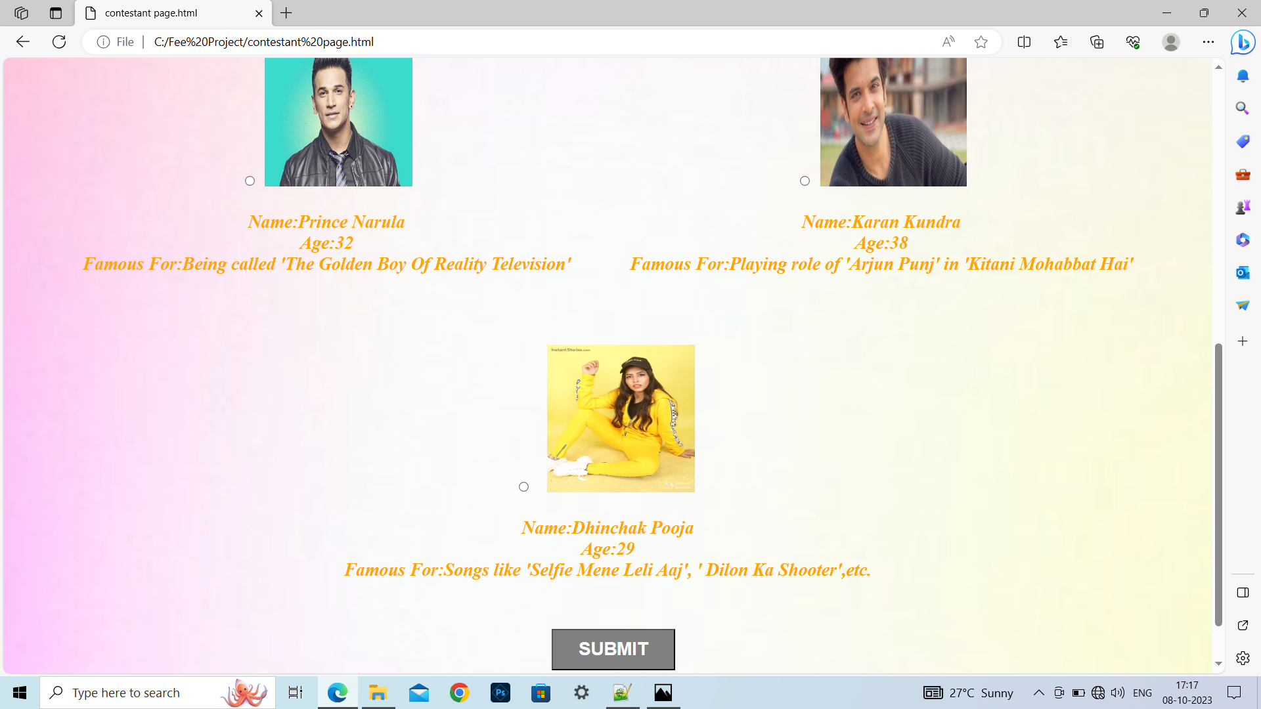
CONTESTANTS PAGE

Slide 12
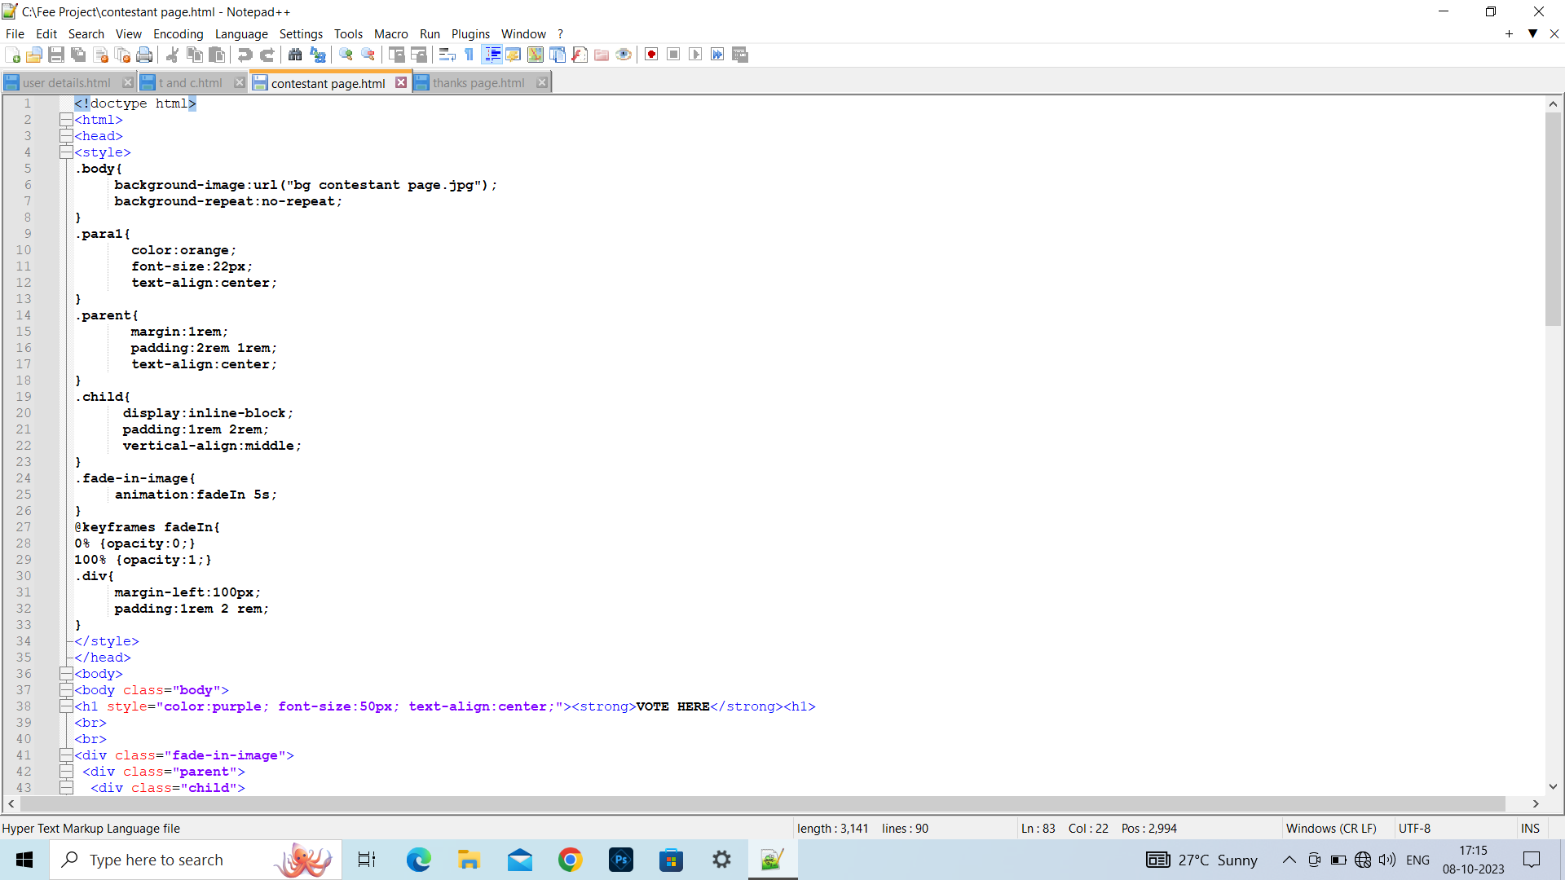
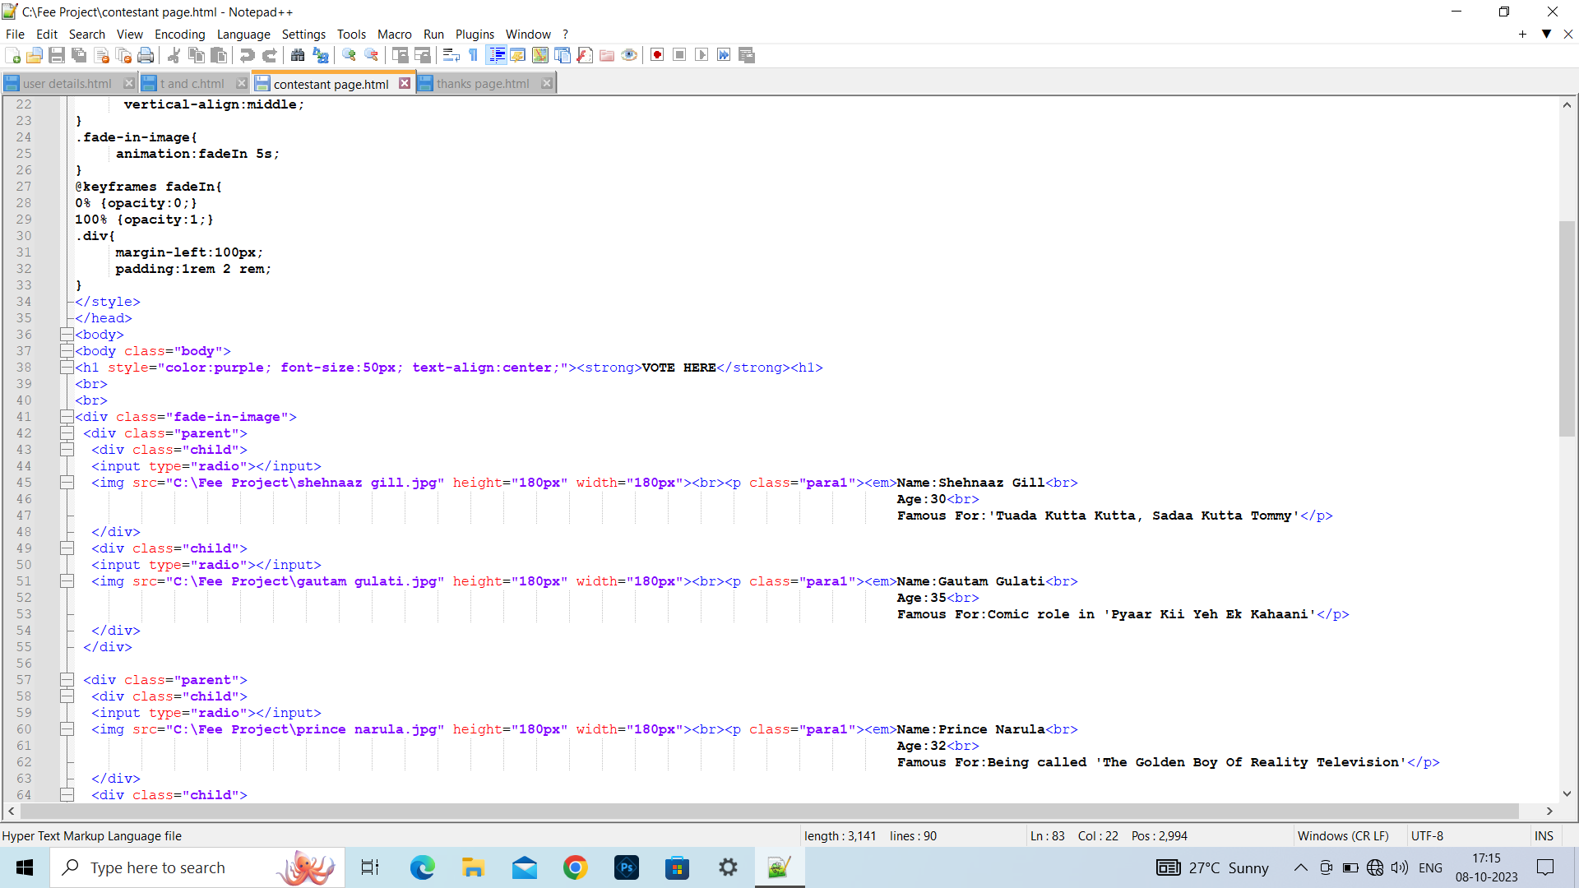
html code part 1
html code part 2

Slide 13
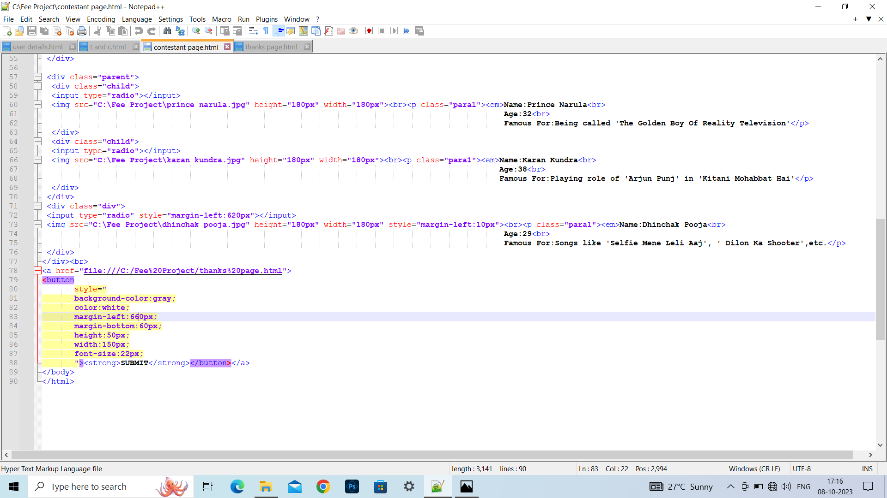
CONTESTANTS PAGE html code part 3

Slide 14
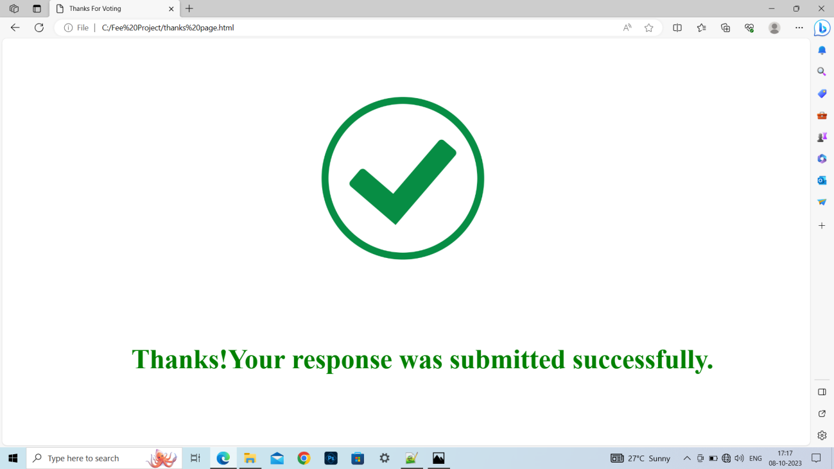
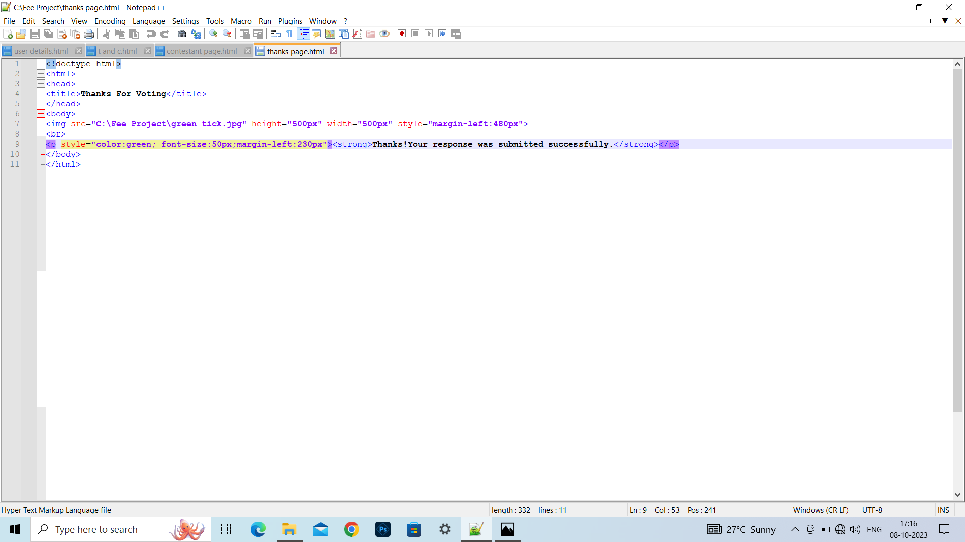
THANKS PAGE

Slide 15
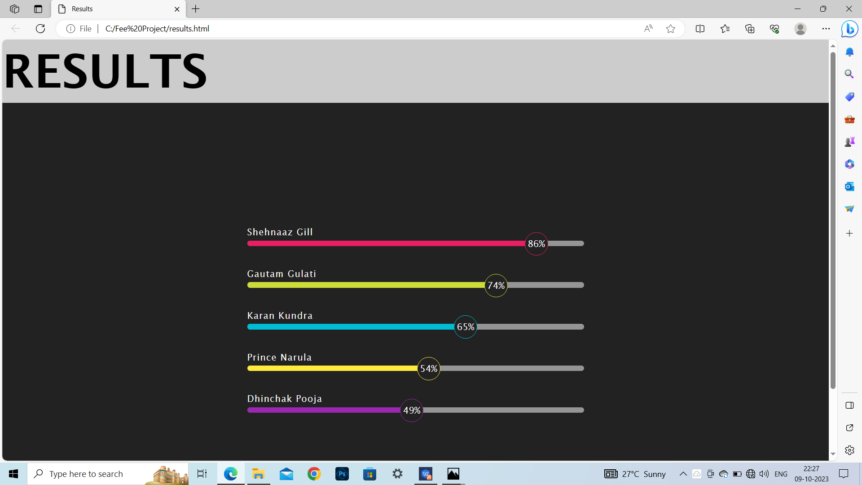
RESULTS PAGE

Slide 16
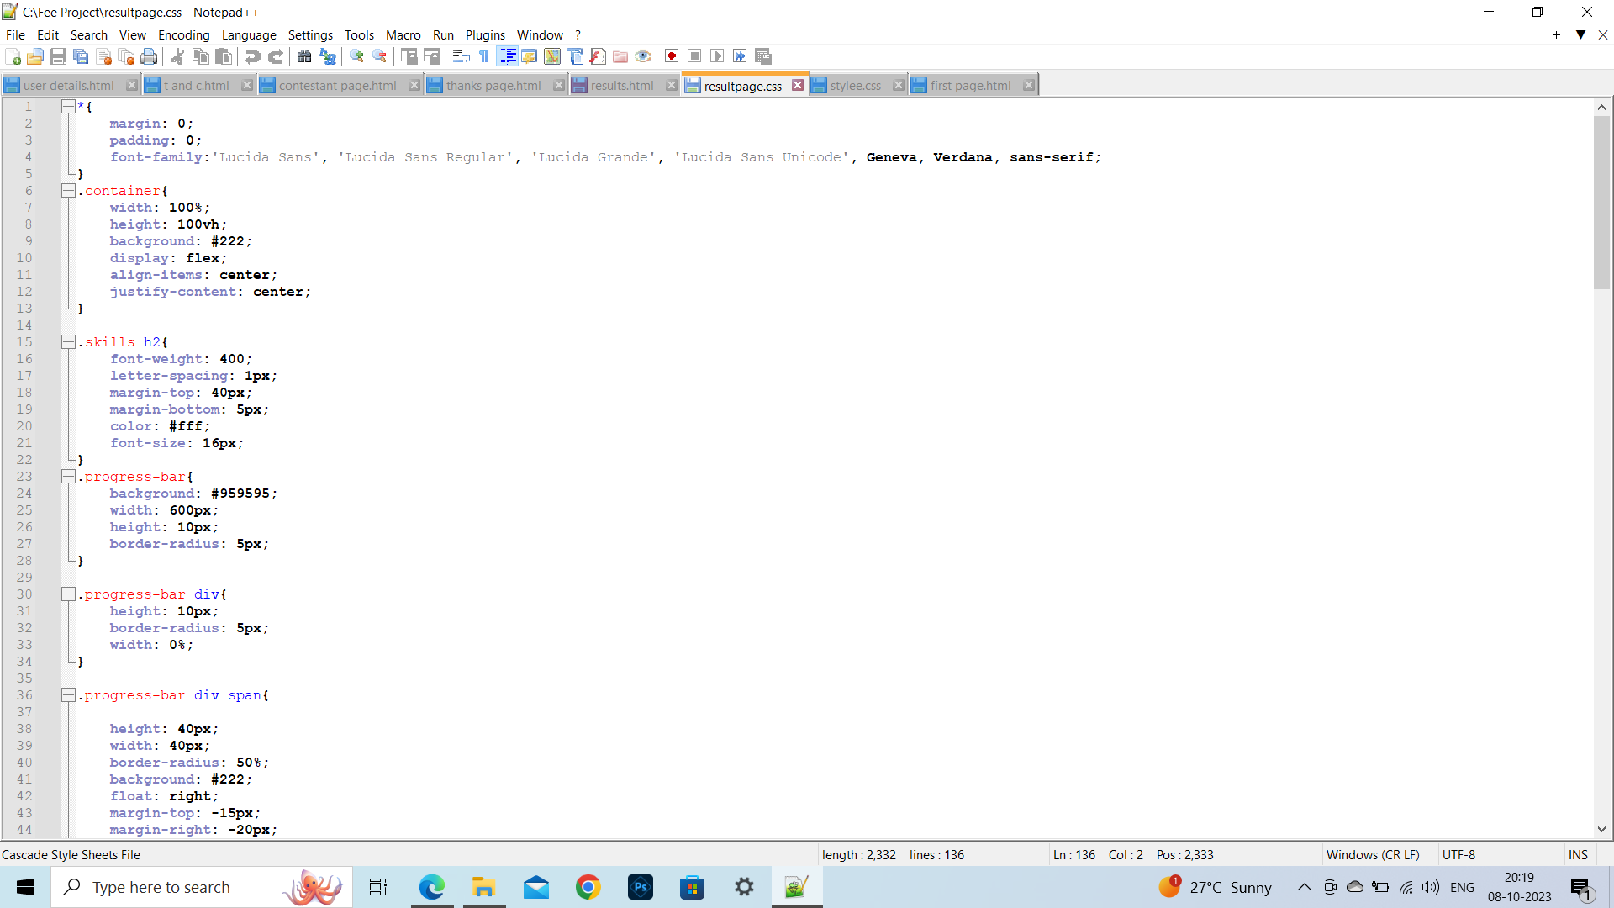
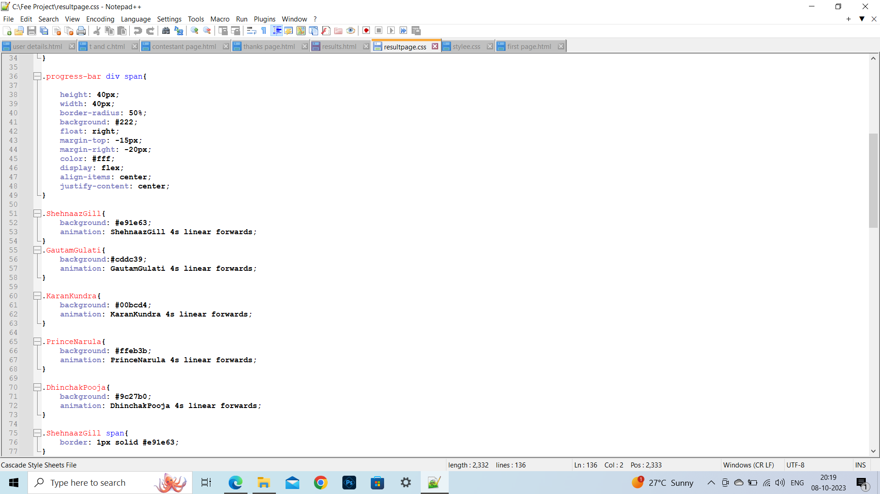
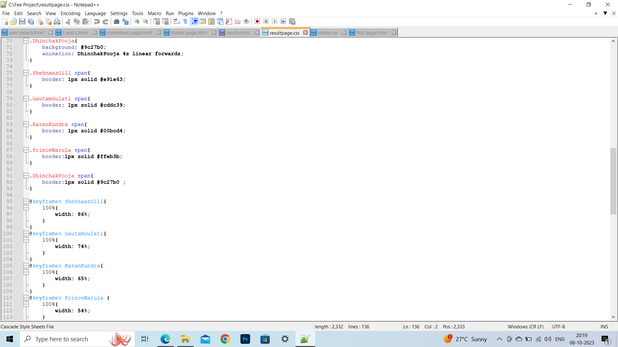
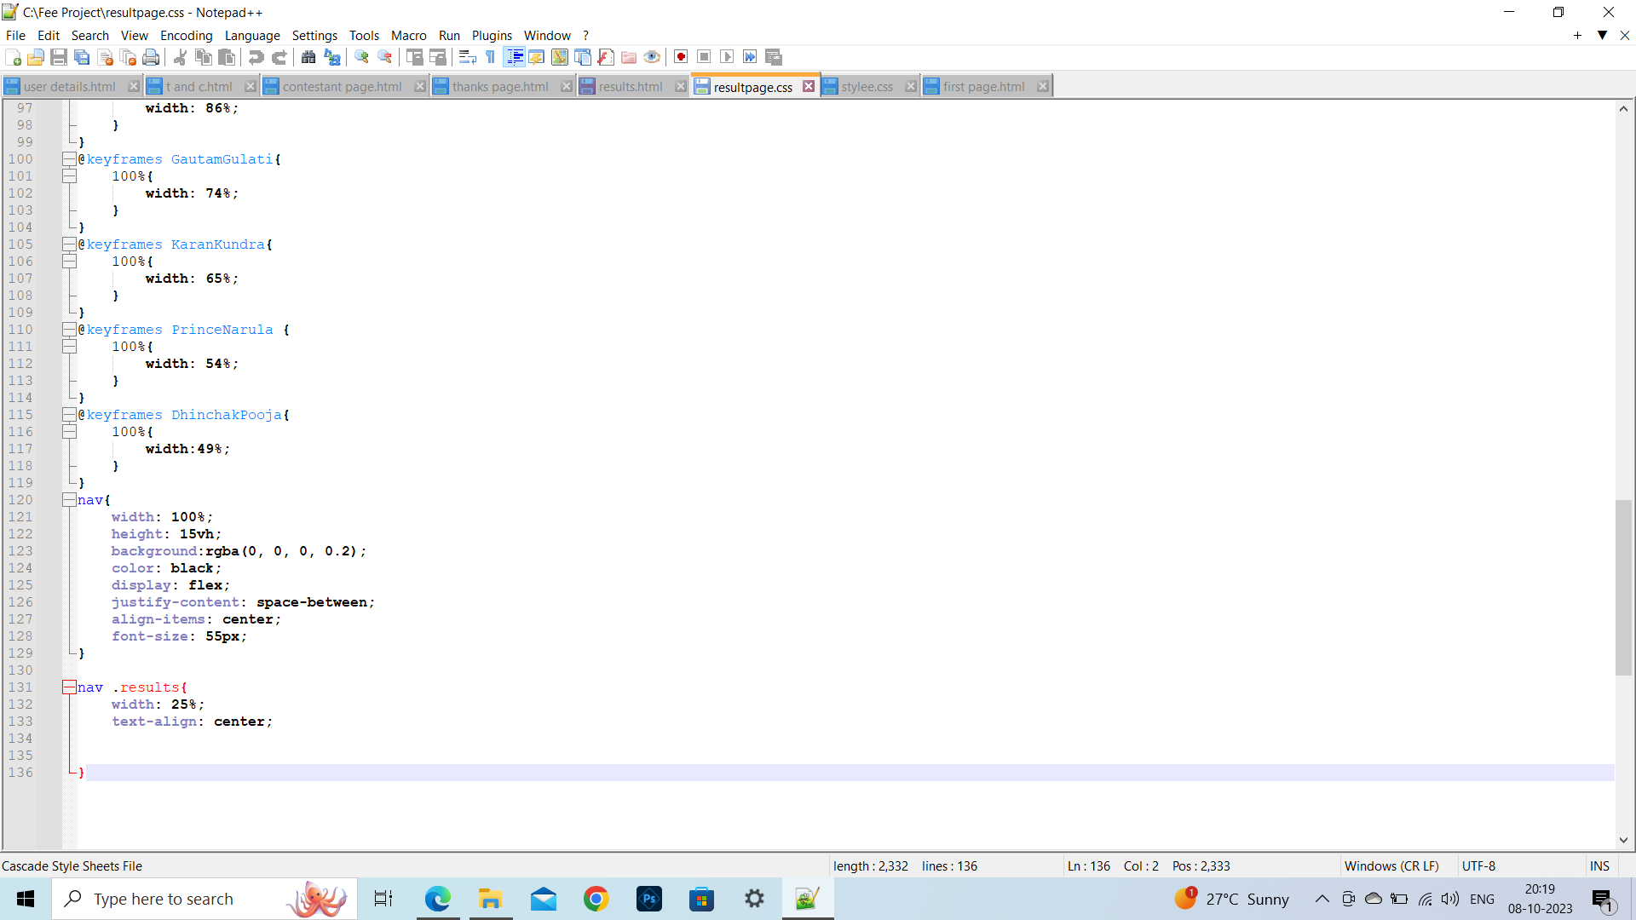
RESULTS PAGE CSS code part 2
RESULTS PAGE CSS code part 1
RESULTS PAGE CSS code part 3
RESULTS PAGE CSS code part 4

Slide 17
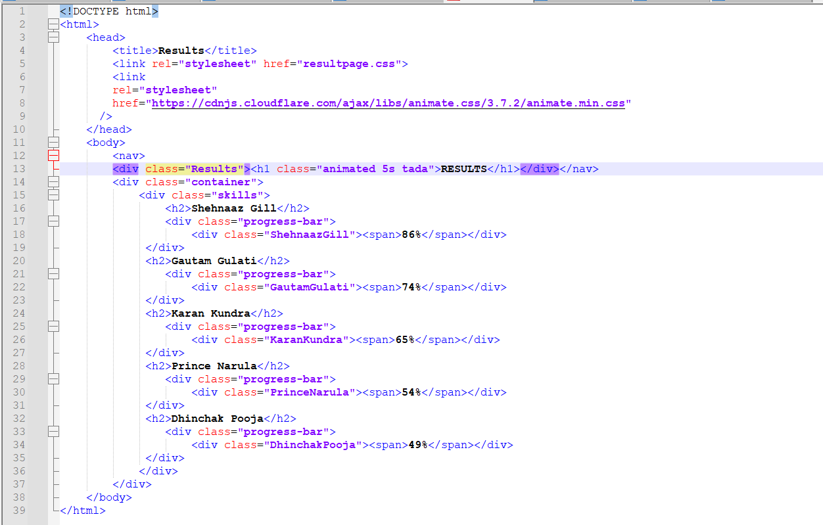
RESULTS PAGE html code

Slide 18
Conclusion
The project is made using different tags of html, different styles of CSS,their co-relation with each other,so our major takeaways are the use of these tags and properties and become familiar and comfortable with them.

Slide 19
References/Links used
https://fonts.googleapis.com/css2?family=Josefin+Sans&display=swap
https://cdnjs.cloudflare.com/ajax/libs/animate.css/3.7.2/animate.min.css
W3Schools
Youtube
Google

Slide 20


